Slide 1
Subscriber Optimization: Rosetta Stone
Arman, Nathan, Thalia, Dexter, Emily

Slide 2
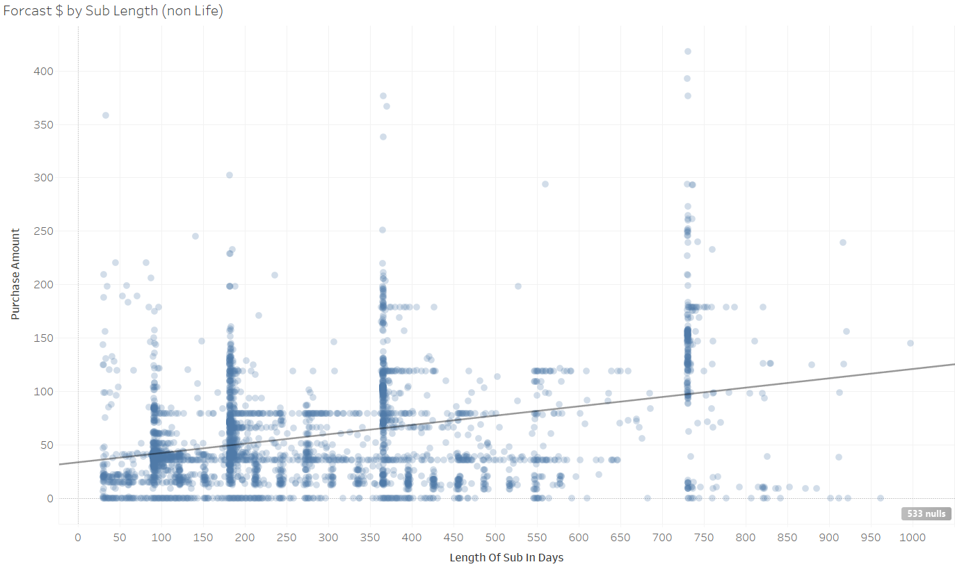
Analysis Plan and Data Exploration
Performed Exploratory Data Analysis using Excel and Tableau to generate Pre-Viz around the data.
Created A Correlation Matrix to find relationships within the data

Slide 3
Data Cleaning
Data Engineering:
Removed App Purchase Info (denoted in data dictionary as impossible)
Converted GBP, EUR to USD
Created new metric for subscription length by taking the difference between start and expiration
Created Send to Open metric resulting in a percentage of emails opened per person
Created Open to Click metric that results in a percentage of emails opened that got clicked on
Data Combining:
Took the ID for Activity and Matched to Subscription Info. Took a Aggregate count of # of activities logged per id
Added this as a attribute for the Subscription Info.

Slide 4



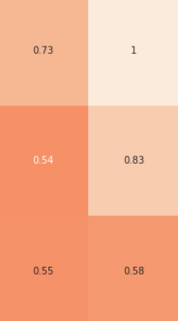
P Amount V Subscription Type - Lifetime
P Amount V Subscription Length
Open
Click
Unique Open Count

Slide 5
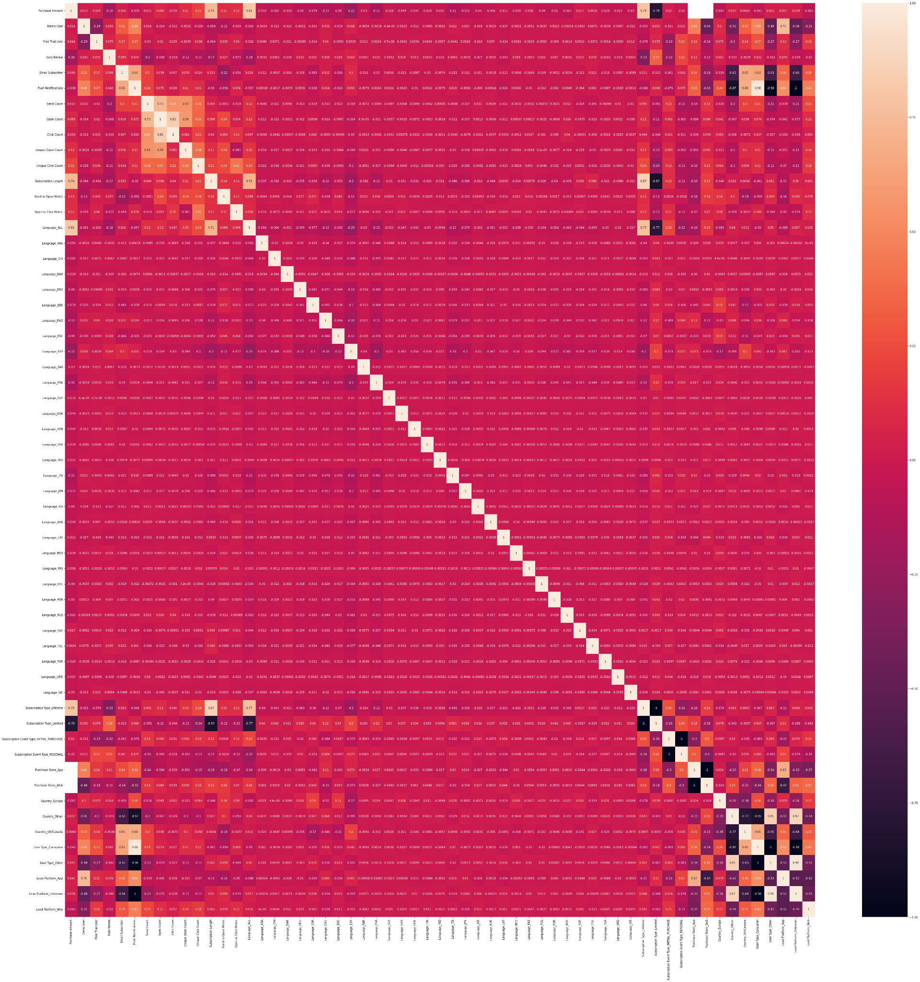
So what's the best path here?
We decided to veer towards Performing Analysis Mostly Based on Tableau and Business based research

Slide 6
Understanding Subscriber Segments
01
02
03
Type of Plan Purchased
(Free trial user, Monthly user,
Lifetime user)
Platforms
Being Used
(App or Website)
Locations of Users Based
on Currency
(US, EUR, GBP)

Slide 7
Most Valuable Customers
Lifetime Subscribers
Mobile Users (IOS)
US/Canada consumers
Consumers learning TAG, SVE, ENG, and ARA

Slide 8
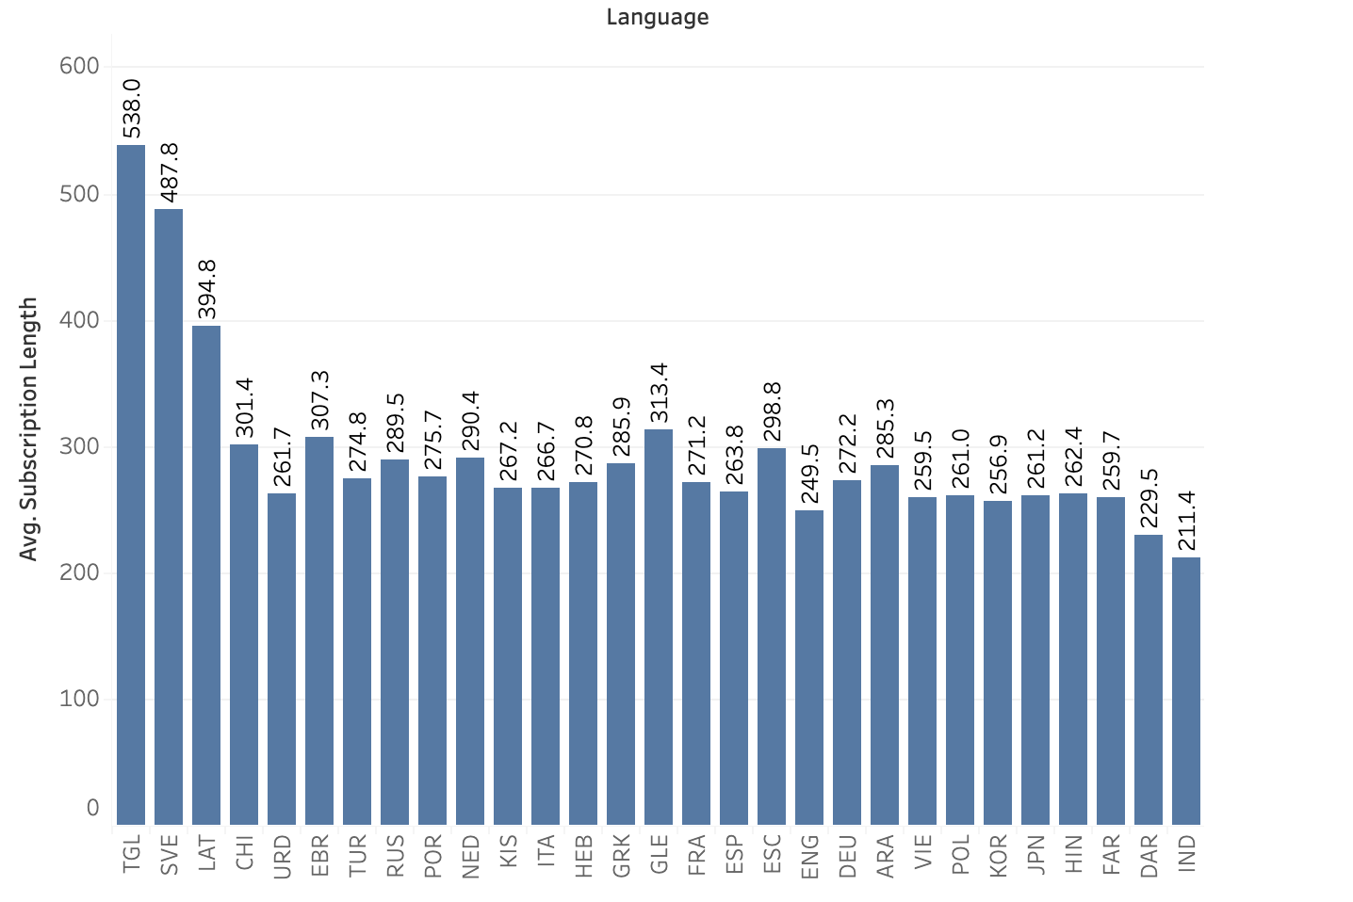
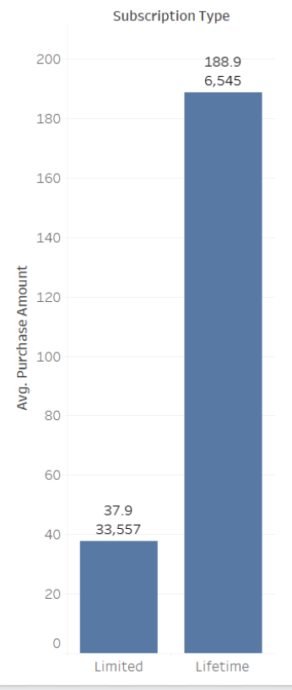
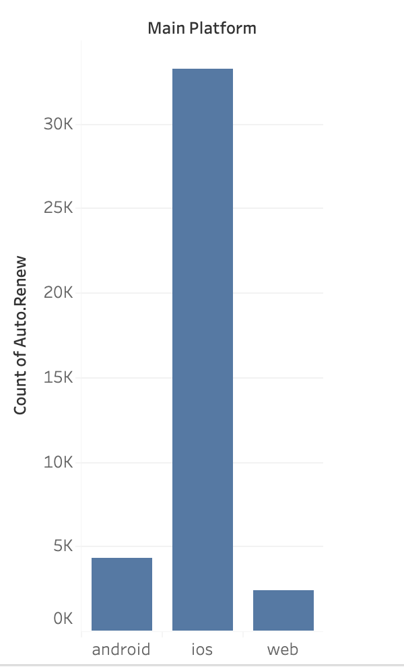
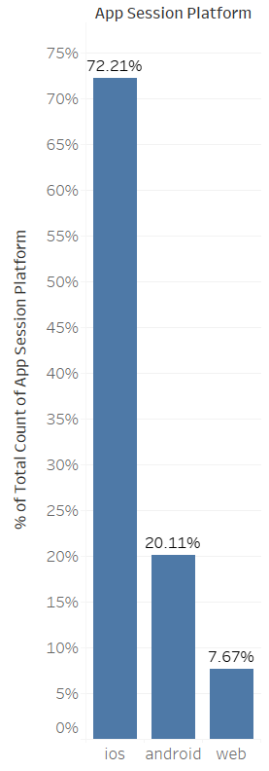
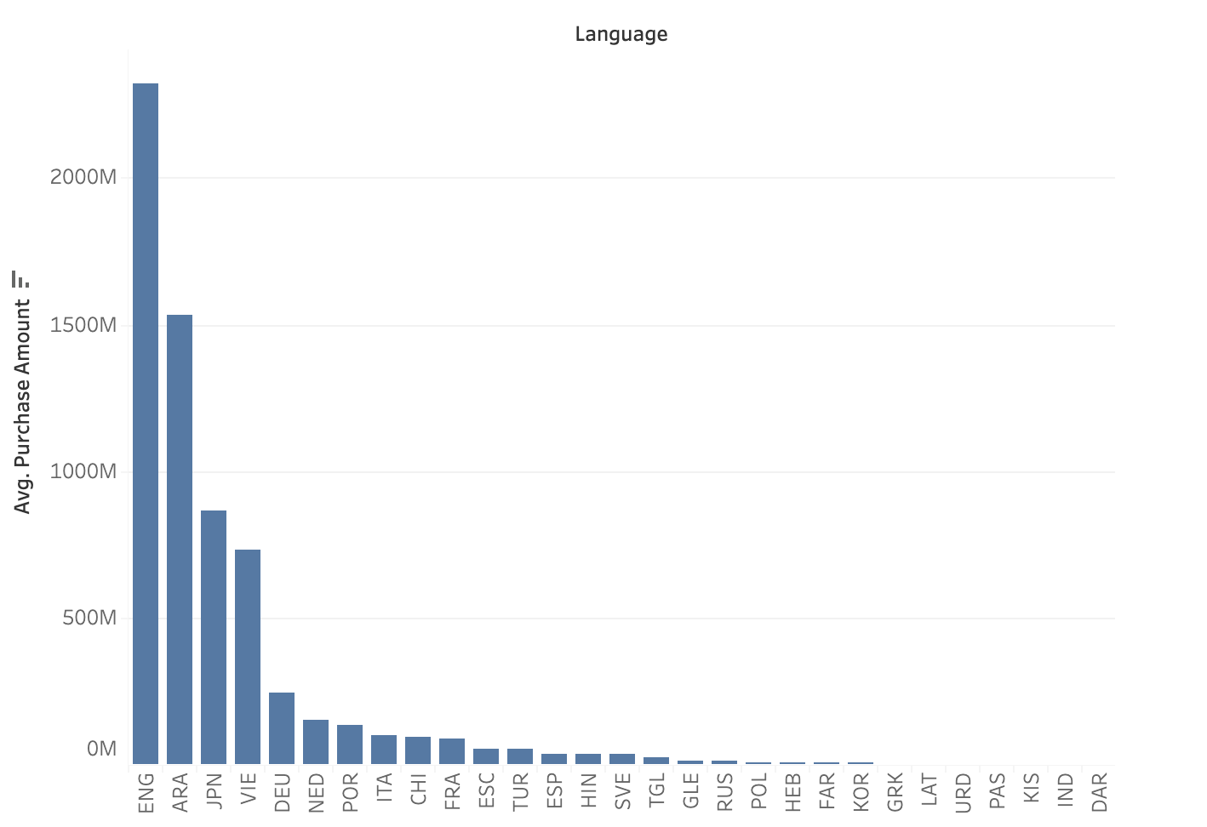
Most Valuable Customers

Slide 9
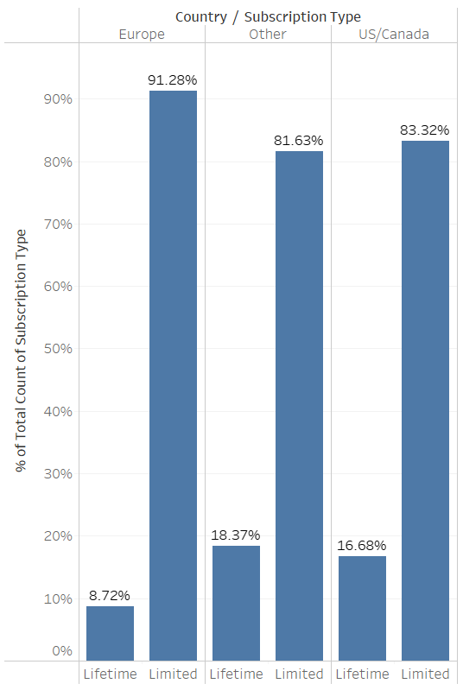
Subscribers To Upsell
For all european subscribers, only 8.72% of subscriptions are lifetime accounts. Though the total european subscribers is dwarfed by the US, 16.68% of all US subscriptions are lifetime memberships
This leads to a market opportunity pushing active euro subscribers to re-up with a lifetime subscription

Slide 10
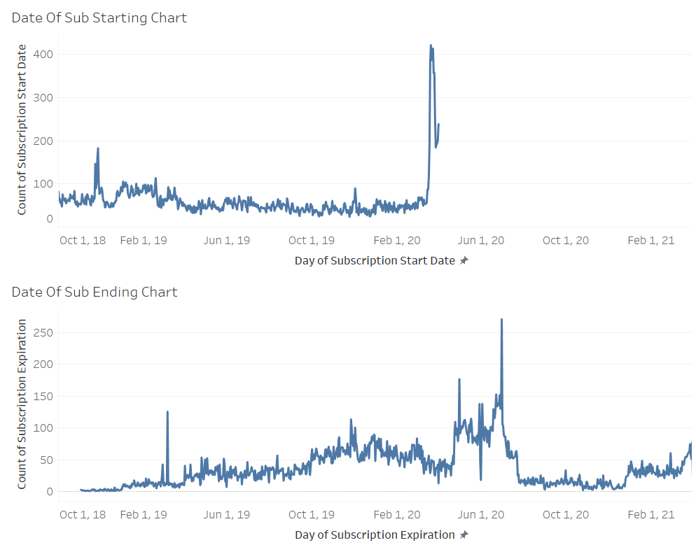
How?
Email campaigns with targeted discounts during months with high subscription counts.
End of year ad campaign to target expiring subscribers as well as shroud discount with a holiday/new year resolution theme.

Slide 11
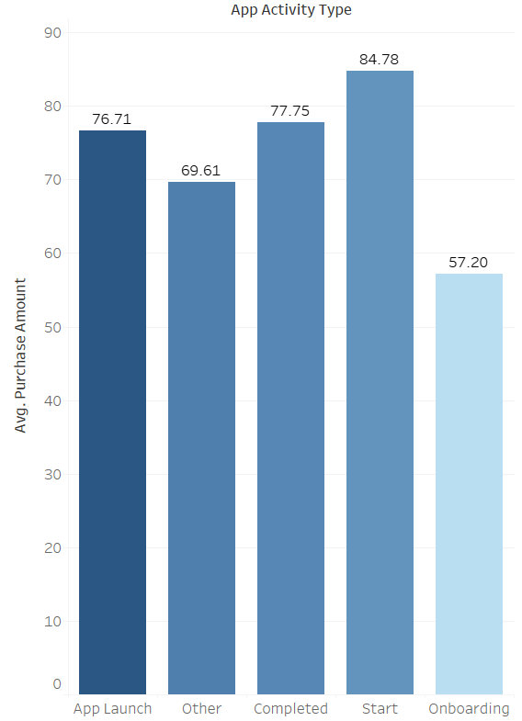
Product Usage
Trial User Conversion
App Activity To Sub Length and Expenditure

Slide 12
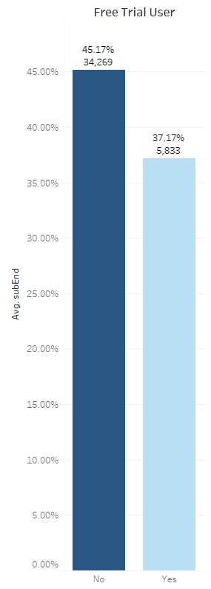
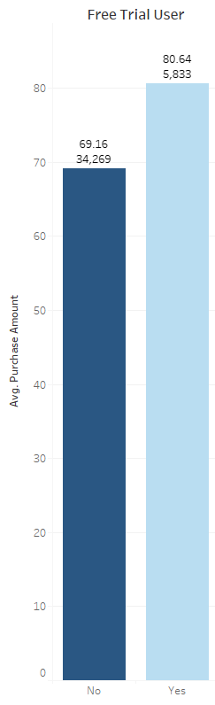
Trial User Conversion
Trial Users have a higher avg Expenditure compared to non trial users
Chart on the Right
Trial users have a lower chance to have their Subscription done.
Chart on the left
Creating incentives for new users to experience the trial first could lead to increased Revenue and less hesitation/flaking of their subscription.
This has the biggest impact in Europe

Slide 13
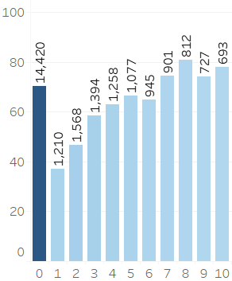
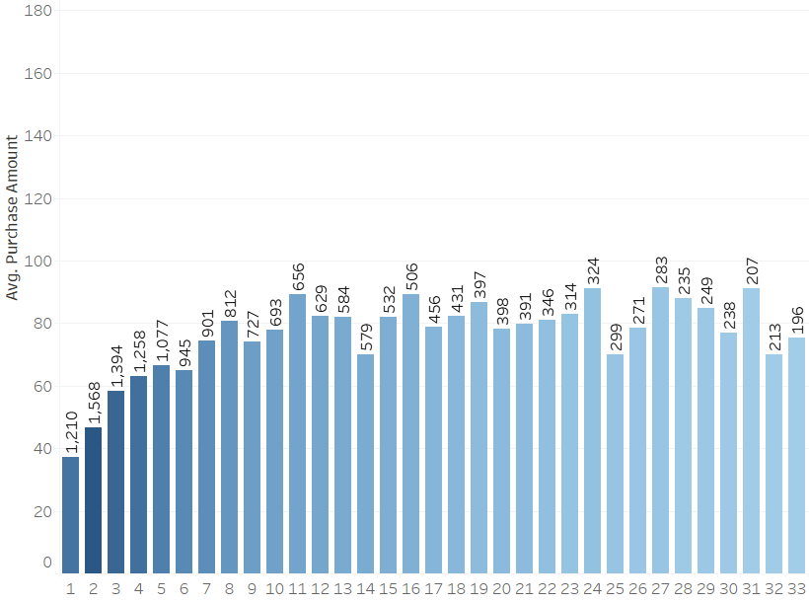
App Activity To Sub Length and Expenditure
Tracking number of activities logged by ID. There is a large amount of the user base that never touches this app.
The Trend of the data shows the more someone uses the apt the lower their average purchase amount is
In fact “Dead Users” could be seen as a positive… :)
(For Lifetime Subscribers. Activity is a negative surprisingly)

Slide 14
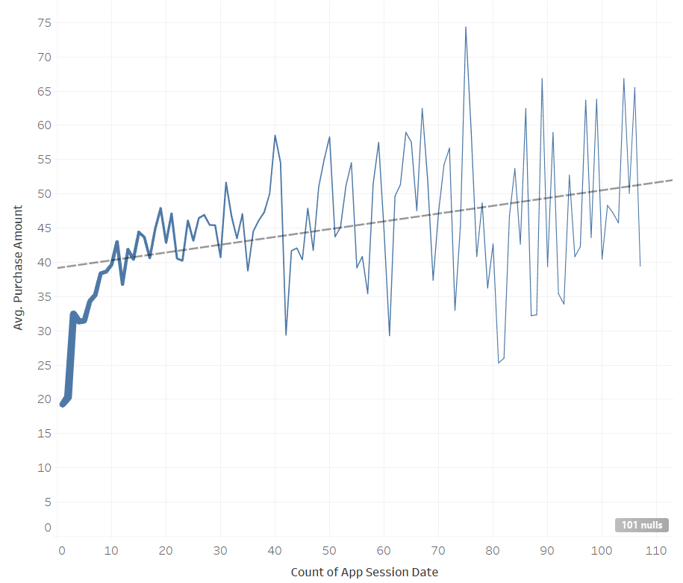
App Activity To Sub Length and Expenditure
That being said. When we exclude Lifetime users.
When Activity increases The Average Purchase amount does increase.
Focusing on sending email reminders to limited users to check into the app could result in those limited users subbing for longer
We can ignore sending these to lifetime subs.

Slide 15
Continued Opportunities
Exploring competitor offerings
&
Ensuring continued market control

Slide 16
Exploring Competitor Offerings
Given the mobile connected landscape today, offerings such as Duolingo, Babbel, and Memrise have grown in popularity
Services such as Duolingo, Babbel, and Memrise offer community engagement, explicitly taught grammar, and crowdsourced knowledge respectively
34 hours of Duolingo equates to 1 semester of university level language education according to a 2012 study title “Duolingo Effectiveness Study”
It’s important to ensure that Rosetta Stone’s offerings are still competitive in the current landscape of offerings
Notes:
2012 study titled “Duolingo Effectiveness Study” done by Roumen Vesselinov, PhD from City University of New York & John Grego, PhD from University of South Carolina found that 34 hours of Duolingo == 1 semester of Uni level language education

Slide 17
Ensuring Continued Market Control - A lesson in History
Skype was once the leading video conference platform
Skype → “video call”
Due to mismanagement and company misdirection, Skype has died out and quickly replaced with Zoom
“Convenient learning” is being pushed as the new standard amongst app users
Revenue within the language learning sector jumped 32% to $8.21 billion in 2021 alone. Online services account for only 12% of total income
Memrise and Duolingo lead in the app sectors
Rosetta Stone should consider expanding their app based services to compete in the growing market in addition to online web based services
Notes:
Skype bought by Microsoft for $8.5 billion
According to Meticulous Research and MarketsandMarkets, “revenue within the language learning sector jumped 32% to $8.21 billion in 2021 alone. Online services account for only 12% of the total income”

Slide 18
THANKS!

